Slide 1
Micro-Credit Defaulter
By Deepthi Prakashan

Slide 2
Introduction
Microfinance refers to giving small loans to individuals with lower socioeconomic background who typically lack collateral, employment or have a low-income job.
Provision of loans as mobile balances as a microcredit is a challenging task since it requires evaluating the creditworthiness of consumers.
The institutional sustainability and its ability to provide with financial services depends on the reducing loan risk and providing loans to individuals who are considered “creditworthy”
Our task would be to predict the creditworthiness of customers so as to avail them with micro-credit loans.

Slide 3
Problem Statement
A telecom company is collaborating with an MFI to provide micro-credit on mobile balances to be paid back in 5 days. The Consumer is believed to be defaulter if he deviates from the path of paying back the loaned amount within the time duration of 5 days. For the loan amount of 5 (in Indonesian Rupiah), payback amount should be 6 (in Indonesian Rupiah), while, for the loan amount of 10 (in Indonesian Rupiah), the payback amount should be 12 (in Indonesian Rupiah).
However, it is risky to provide every individual with a loan. When an individual applies for micro credit loans, we need to assess if they would repay the loan. It is on this basis that we determine whether to approve or decline the application.
In order to improve the selection of customers for the credit, we need to build a machine learning model which will make predictions based on the credit history and other information of the customers from the database provided to us. This could help the client in further investment and improvement in selection of customers.

Slide 4
Work Flow
Importing libraries and dataset
Exploratory data analysis
Data pre-processing
Building Models (RandomForestClassifier, DecisionTreeClassifer, AdaBoostClassifier, GradientBoostingClassifier, kNN Classifier)
Model Evaluation using Confusion matrix, Precision, Recall, Cross-validation
Saving Model

Slide 5
Exploratory Data Analysis
The data has been received from FlipRobo Technologies
The data is in csv file format
There as 209593 rows and 37 columns
Label is the target column where 1 denotes the person is a defaulter and 0 if they are not.
The dataset is imbalanced. Label ‘1’ has approximately 87.5% records, while, label ‘0’ has approximately 12.5% records.

Slide 6
Data Cleaning/ Data pre-processing
pdate was separated into month date and years columns
Unnecessary columns that were dropped:
Unnamed:0,
msisdn (mobile number),
pcircle,
Year
Descriptive Statistics:
describe() function gave us an overall summary of the dataset.
Most of the features were observed to be right skewed.
Columns were seen to contain negative values. The following column values were converted to positive values:
aon, daily_dec30, daily_decr90, rental30, rental90, last_rech_date_ma, last_rech_date_da, medianmarechprebal30, medianmarechprebal30.
medianamnt_loans90, medianamnt_loans30, fr_da_rech90, cnt_da_rech90, fr_da_rech30, cnt_da_rech30, last_rech_date_da, have above 90% data as zero. Due to the lack of variation in the data it will not contribute much to the prediction and was dropped.
Using boxplot, a lot of outliers were detected which were later replaced by mean/ median values.

Slide 7
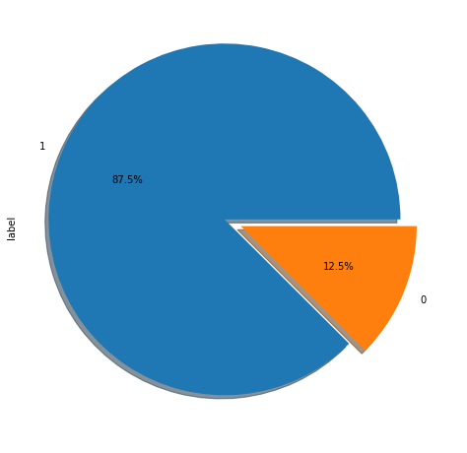
Data Visualization
We see that 87.5% have paid the loan in time and 12.5% have failed to pay

Slide 8
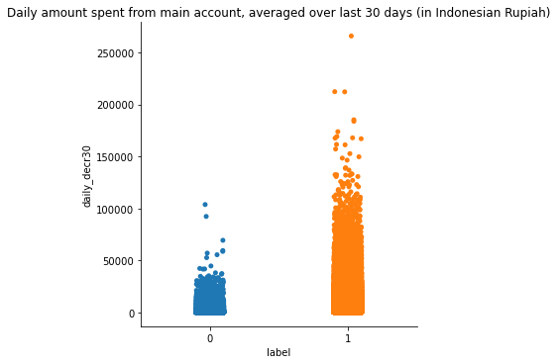
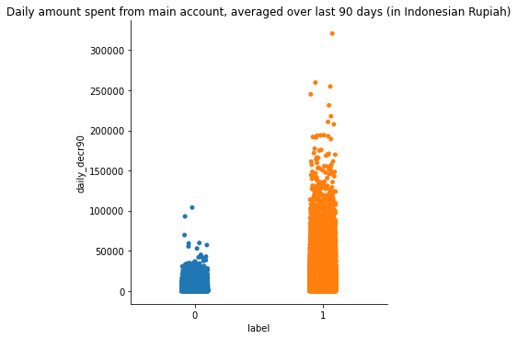
Daily amount spent averaged over last 30 days for defaulters is less as compared to non-defaulters.
Daily amount spent averaged over last 90 days for defaulters is less as compared to non-defaulters.

Slide 9
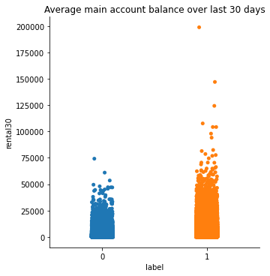
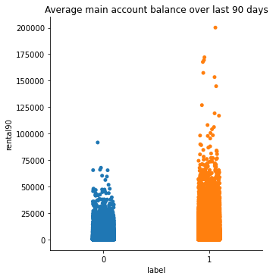
Average main account balance 30 days for defaulters is less as compared to non-defaulters.
Average main account balance 90 days for defaulters is less as compared to non-defaulters.

Slide 10
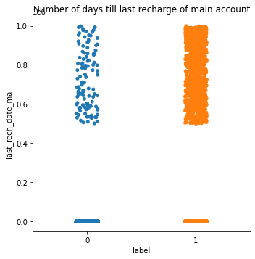
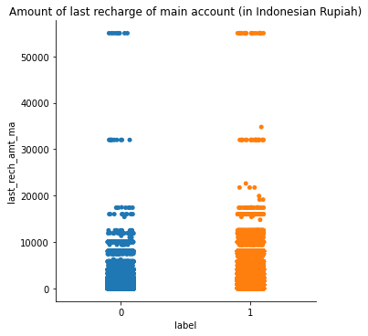
No difference can be observed for 'last_rech_date_ma’
No difference can be observed for 'last_amt_date_ma'

Slide 11
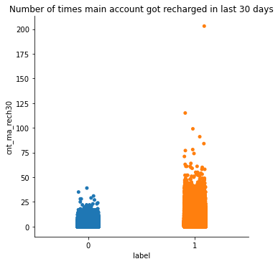
The number of times defaulters have recharge is lesser as compared to non defaulters

Slide 12
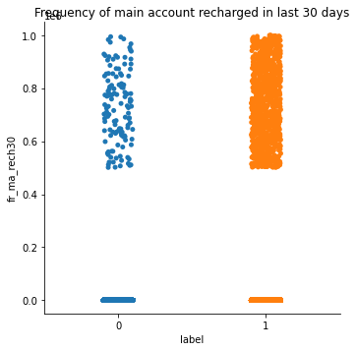
Frequency of main account recharged in last 30 days show no difference in trend between defaulters and non-defaulters.

Slide 13
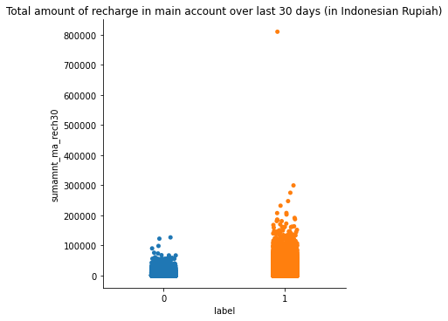
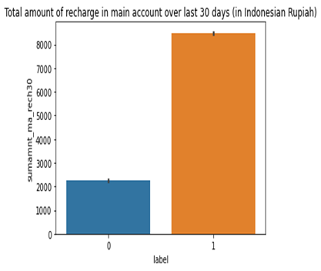
Total amount of recharge in main account over last 30 days is comparatively less for defaulter’s account
On average, total amount of recharge for defaulters in main account is found to be 2000.
For non-defaulters, this value is found to be 8000, which is projected slightly higher due to the presence of a seemingly impossible outlier.

Slide 14
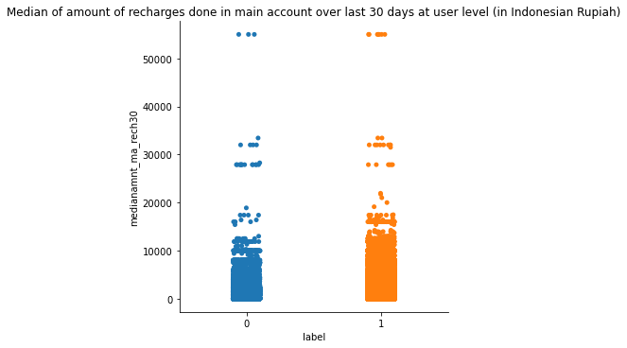
There is no observable trend between defaulters and non-defaulters in case of Median of amount rechargers’ done in main account over last 30 days at user level

Slide 15
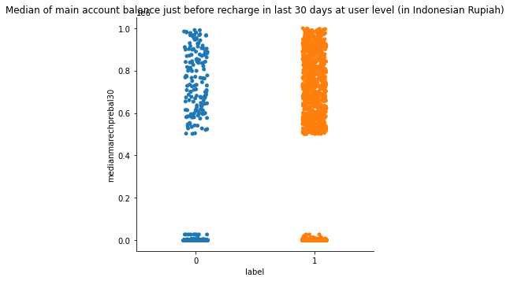
Median of main account balance just before recharge in last 30 days does not show any trend difference

Slide 16
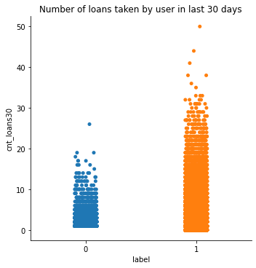
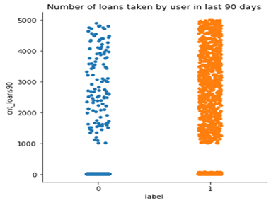
Number of loans taken by defaulters in last 30 days is lesser as compared to non- defaulters
However, number of loans taken by defaulters in last 90 days seem to have no difference in trend.

Slide 17
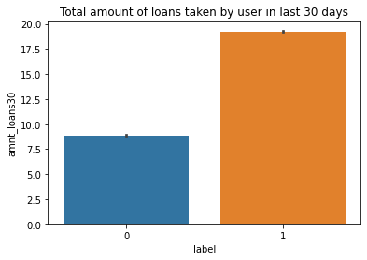
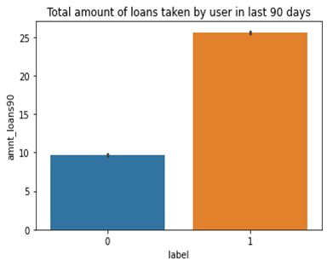
Total amount of loans taken by defaulters in 30 days is less than non-defaulters. While defaulters on average only took 7-8 loans, non- defaulters are seen to take about 20 loans.
Total amount of loans taken by defaulters in 90 days is far less than non-defaulters. While defaulters on average only took 10 loans, non- defaulters are seen to take about 25 loans.
This is an indication that non- defaulters repay soon so they were able to avail the next loan.

Slide 18
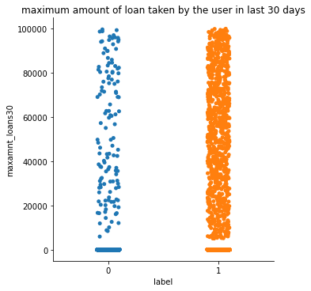
Maximum amount of loan taken by defaulters and non-defaulters show similar trend.

Slide 19


Number of loans taken by defaulters in last 30 days is lesser as compared to non- defaulters.
However, number of loans taken by defaulters in last 90 days seem to have no difference in trend.

Slide 20
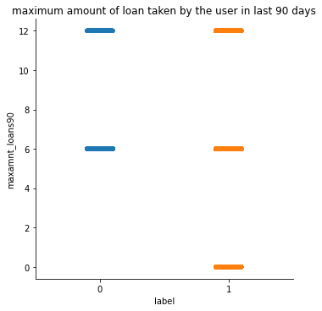
Maximum amount of loans taken by the user in last 90 days is see to be either 6 or 12 for defaulters and non-defaulters. In case of non-defaulters there are some users who have never taken any loans

Slide 21
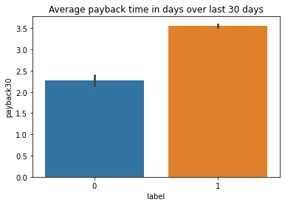
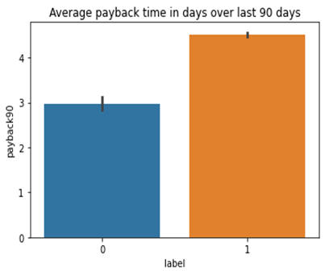
Average payback time in days over last 30 days is seen to be 2- 2.5 days for defaulters
Average payback time in days over last 30 days is seen to be 3 days for defaulters
Average payback time over last 90 days for defaulters is seen to be 3 days and non-defaulters it shows 4 days.

Slide 22
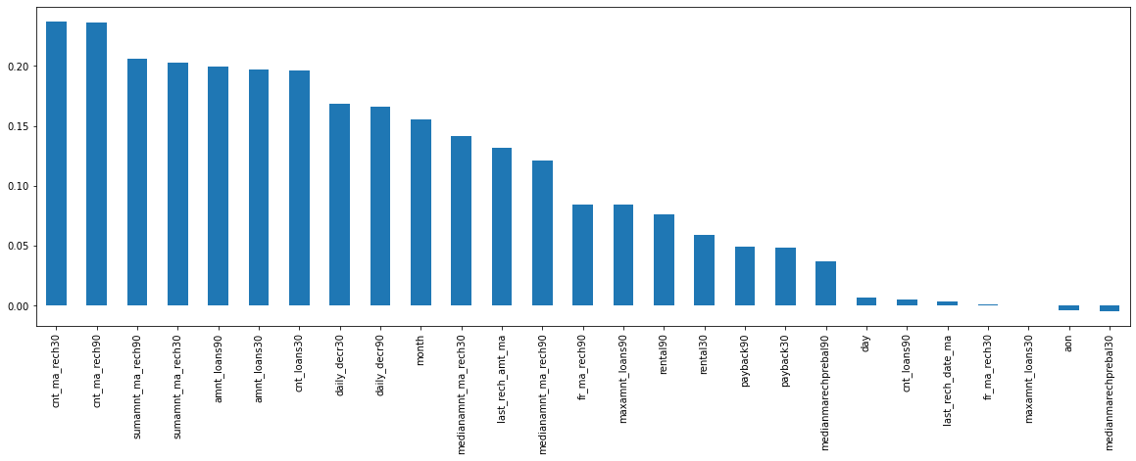
Correlation
Correlation Analysis was visualized through a heatmap and a bar plot. It was observed that most of the features were positively correlated, but we can see that all the features have value of correlation less than 0.3.

Slide 23
Evaluation of Algorithms

Slide 24
RandomForestClassifier
Here our model has predicted the test dataset with an accuracy of 95.11%.Further quantitative assessment for the performance of the model was made using other metrics such as precision, recall and ROC-Curve. Our model was able to correctly identify 95 defaulters from the 100 cases predicted as defaulters giving it a 95% precision. Out of all the defaulters, the model was able to catch 96% of the defaulters.

Slide 25
DecisionTreeClassifier
This model predicts with an accuracy of 91.27%. It correctly identified 91% defaulters from the total cases predicted as defaulters. Recall was found to be 92%, suggesting that it was able to catch 92% of the defaulters from the total number of defaulters. On cross validation, we did get a score close to the accuracy score, suggesting that it is not overfitting/underfitting. Overall, we see that RandomForestClassifier has performed better than DecisionTreeClassifier in all aspects.

Slide 26
KNeighborsClassifier
KNeighborsClassifier has predicts with an accuracy of 90.26%. Among all the models, it has the lowest precision. So, it is only able to correctly predict 84% cases from total cases predicted as defaulters. However, the model overcompensates by catching 99% of the defaulters. While this model is beneficial for the company as it is able to catch most of the defaulters, yet from a customer point of view this can cause dissatisfaction among them as it categorizes relatively higher percentage of the non-defaulters as defaulters.

Slide 27
AdaBoostClassifier
AdaBoostClassifier predicts with an accuracy of 84.9%. It was able to correctly predict only 84% from the predicted defaulters. And the recall was found to be only 86%. Thus, it is comparatively a poorly performing model.

Slide 28
GradientBoostingClassifier
GradientBoostingClassifier has an accuracy score of 89.92%. It is able to correctly predict 89% from the predicted defaulters. Its recall is found to be 91%.

Slide 29
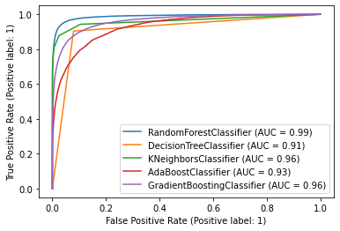
ROC-AUC Curve
ROC is the probability curve. AUC is the area under that curve and tells us how much the model is capable of distinguishing between the classes
RandomForestClassifier is performing better than the rest and has an AUC of 0.99

Slide 30
Result
The best model was selected to be RandomForestClassifier that gave an accuracy, precision, recall and ROC-AUC score of 95.47%, 95%, 96%, 99% and 0.99 respectively.

Slide 31
Conclusion
Key Findings and Conclusions of the Study
Defaulters were seen to recharge their main account less number of times.
They are also seen to take fewer number if loans.
Learning Outcomes of the Study in respect of Data Science
The best model was selected to be RandomForestClassifier that gave an accuracy, precision, recall and ROC-AUC score of 95.47%, 95%, 96%, 99% respectively.
However, depending on the business goal, if the company’s focus is on having minimum defaulters, then kNearestNeighbors would be the best model with 99% sensitivity. However, the model has only a precision of 84% which may cause a dissatisfaction in customers who were declined from loans even after being re-payers.
Few challenges that came across while solving the problem was: 1) solving the outliers. Since one of the objectives was to minimize loss of data techniques like Z-score method or IQR could not be used for removing outliers, Hence, the next best option was to replace them with the mean/median values.

Slide 32
Limitations of this work and Scope for Future Work
Due to time constrain, outliers were replaced by mean/median values. However, a better method should be found in dealing with outliers with minimum data loss.
The data we dealt with belong to the year 2016. It would be better if we deal with data ranging from other years and preferably from the past few years, as it will be more significant with the current population trend.

Slide 33
Thank You

